Slide 1
Reproducible Containers
Chris Baldassano
PSYC GR6130, Fall 2019

Slide 2
Schedule
Please push all labs by next week
Next Friday 11/22: Guest lecture by CodeOcean
Friday 12/6:
Final project due by 4pm
Submit as a link to Binder, DockerHub, or CodeOcean (or similar)
In class: 8-10-minute presentations focusing on tools used and why

Slide 3
The missing piece…
I’m using Windows, this command isn’t working…
Wait, is this supposed to be run with Python 2 or 3?
My numpy installation is completely FUBARed…

Slide 4

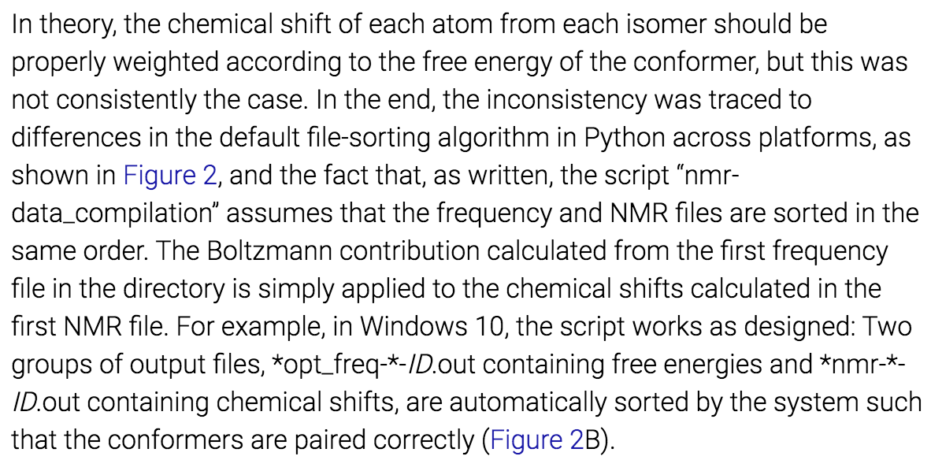

Slide 5
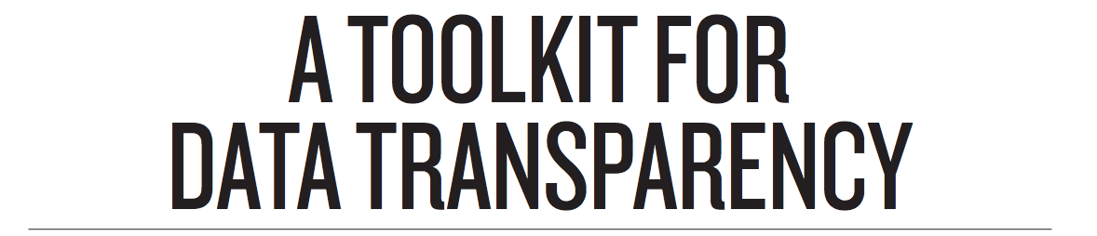
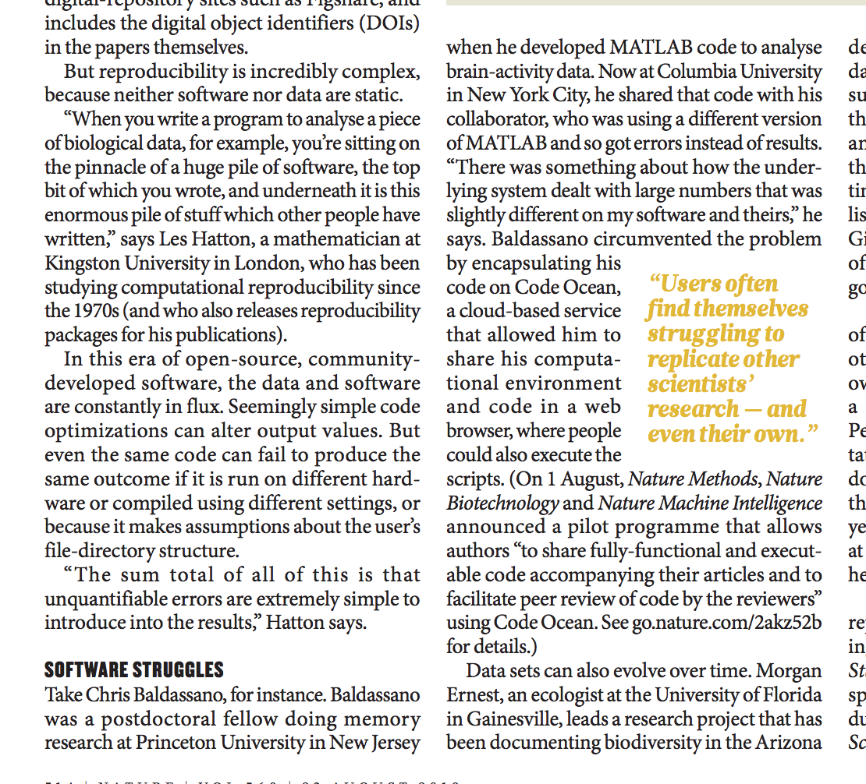

Slide 6
Option 1: describing environment
Most lightweight option: add metadata to your project that specifies its dependencies and their versions, allowing a user to reconstruct your environment on their computer
Python: requirements.txt, environment.yml
R: DESCRIPTION, Packrat

Slide 7
PYTHON: requirements.txt
Plain-text file listing required libraries and versions:
h5py==2.8.0 matplotlib==3.0.2 pandas==0.23.4
Can set up all packages with:
pip install -r requirements.txt

Slide 8
PYTHON: requirements.txt
How to create requirements.txt?
By hand
pip freeze > requirements.txt
Managed by IDEs like PyCharm

Slide 9
Python (CONDA): Environment.yml
Conda environments allow better encapsulation of project-specific sets of libraries
Can describe a conda environment using environment.yml
name: stats channels: - javascript dependencies: - python=3.6 - numpy=1.9.* - nodejs=0.10.* - pip: - Flask-Testing

Slide 10
Python (CONDA): Environment.yml
Can create environment.yml manually, or with:
conda env export > environment.yml
Create an environment with these packages using
conda env create -f environment.yml

Slide 11
R: Description file
Lists dependencies (including version of R), as well as other metadata about the project
(Will talk later today about a tool for building these)

Slide 12
R: Description file
Package: LakeTrophicModelling
Title: Package to reproduce Hollister et al. (2015) Modeling Lake Trophic State: A Randrom Forest Approach.
Version: 0.1
Authors@R: c(person("Jeff","Hollister",role=c("aut","cre"),email="hollister.jeff@epa.gov"), ...
Description: This package contains all the materials needed to reproduce Hollister *et al.* (2015)
Depends: R (>= 3.1.1)
Imports:
randomForest,
varSelRF,
...
License: CC0

Slide 13
R: packrat
Roughly equivalent to conda for python
Creates a private isolated library for a project
packrat::init()
Can “snapshot” this library (creating file packrat.lock)
packrat::snapshot()
and later restore library on another machine
packrat::restore()

Slide 14
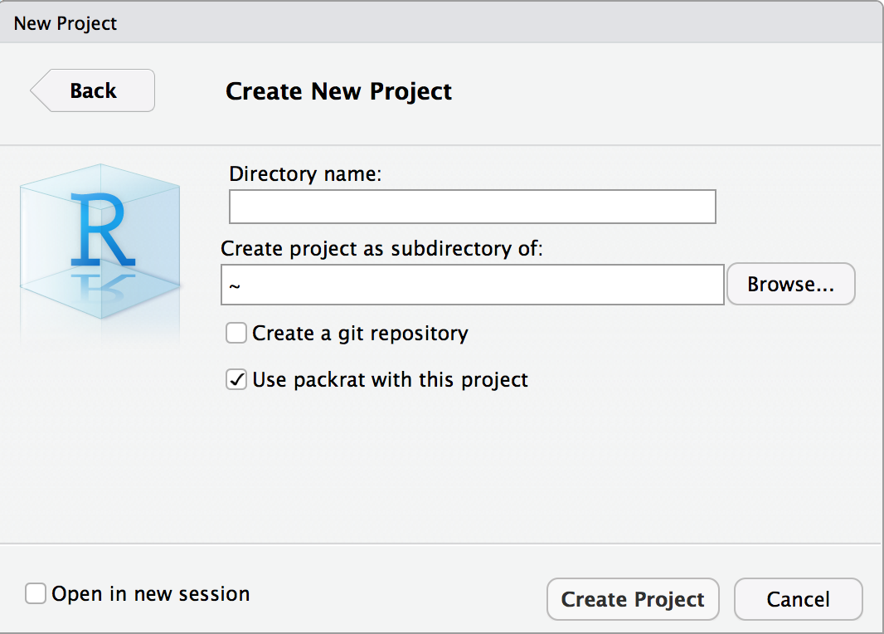
R: packrat

Slide 15
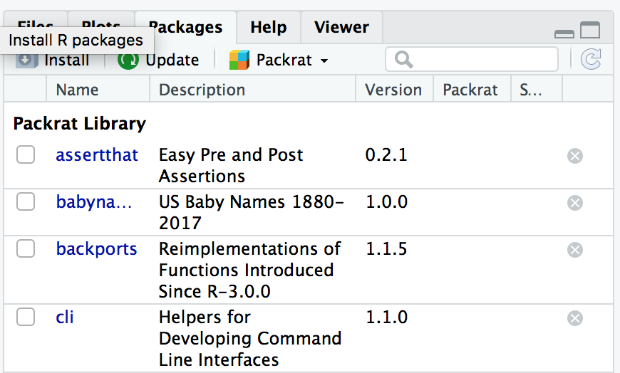
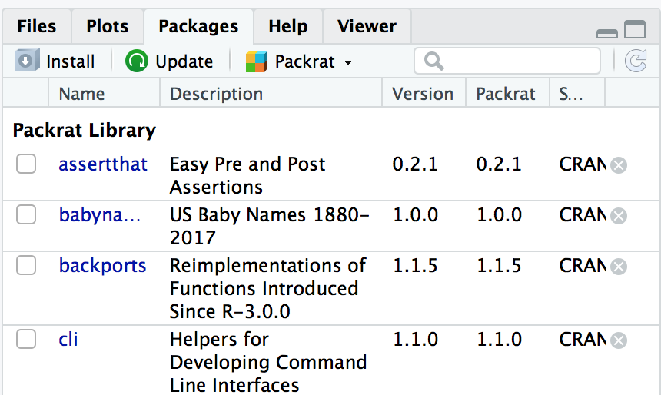
R: packrat

Slide 16
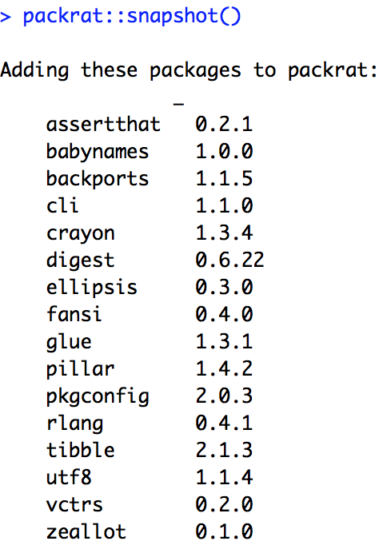
R: packrat

Slide 17
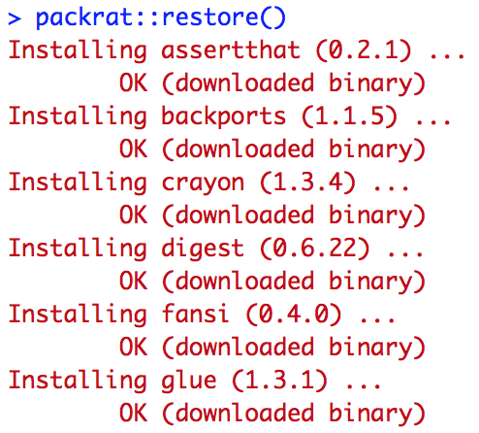
R: packrat
Add packrat/init.R and packrat/packrat.lock to git
After cloning repository to new machine:

Slide 18
Option 2: Portable environment
Create a full computational environment around your project and save as an executable image, which anyone can run without setting anything up (e.g. without even having python/R installed)
Most options currently built around Docker

Slide 19
Beaulieu-Jones, B., Greene, C. Nat Biotechnol 35, 342–346 (2017)

Slide 20
Docker
A Docker image is like a tiny virtual machine* that contains all the software necessary to run your code
Running a docker image creates a live container, which could just run some commands and then quit, or provide an interactive shell
docker run -it debian:latest
root@2dd7203adf8f:/#
virtual machine

Slide 21
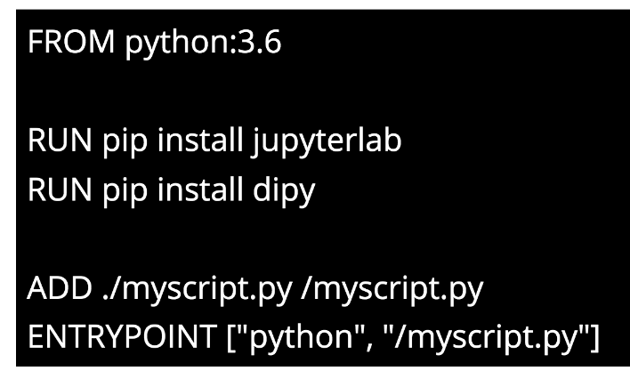
Dockerfile
Can create an image using a dockerfile, usually building FROM some base image
ENTRYPOINT sets a script to run automatically on instantiation
docker build -t image_name:1.0 .
Dockerfile

Slide 22
Neurodocker
Software (which is itself distributed in a docker container) for building dockerfiles with neuroimaging software
docker run --rm kaczmarj/neurodocker:v0.3.2 generate \ --base debian:stretch --pkg-manager apt \ --fsl version=5.0.10 \ --miniconda env_name=neuro \ conda_install="python=3.6 traits" \ pip_install="nipype" > Dockerfile
The string “kaczmarj/neurodocker:v0.3.2” is a URL, pointing to…

Slide 23
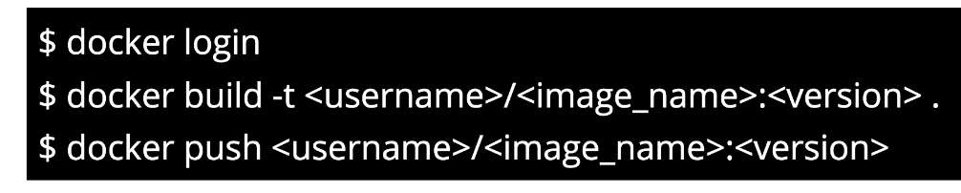
Docker hub
To share Docker images, can push to Docker Hub
Free for public images and up to 1 private image

Slide 24
Reprozip
Another (advanced) way to build a Docker image – run your analysis and monitor all external files/commands it calls (and the underlying OS), then collect them all into a docker image
reprozip trace <command-line>
reprozip pack <package-name>
reprounzip docker setup <package_name>.rpz <docker_dir>/
reprounzip docker run <docker_dir>/

Slide 25
Lab: Holepunch
R library for creating a DESCRIPTION file and a Dockerfile, and generate a link to build the Docker image publicly on Binder
Accept assignment (don’t clone): https://classroom.github.com/a/7fZ_ytkZ
In Rstudio: New Project -> Version Control -> Git, paste clone URL into box, choose directory name and location, Create Project
Open README.md for instructions

